Slide 1
Climate and Soils

Slide 2
Climate

Slide 3
Climate = long term average weather
A = tropical
B = arid
C = temperate
D = cold
E = polar
Notes:
categorizes global climates into five main groups (A-E) based on annual/monthly temperature and precipitation patterns

Slide 4
How would you describe Lubbock’s climate?

Slide 5
Climate = long term average weather
Bsk = cold,
semi-arid

Slide 6
Why do we care about climate?

Slide 7
Earth’s Energy Budget

Slide 8
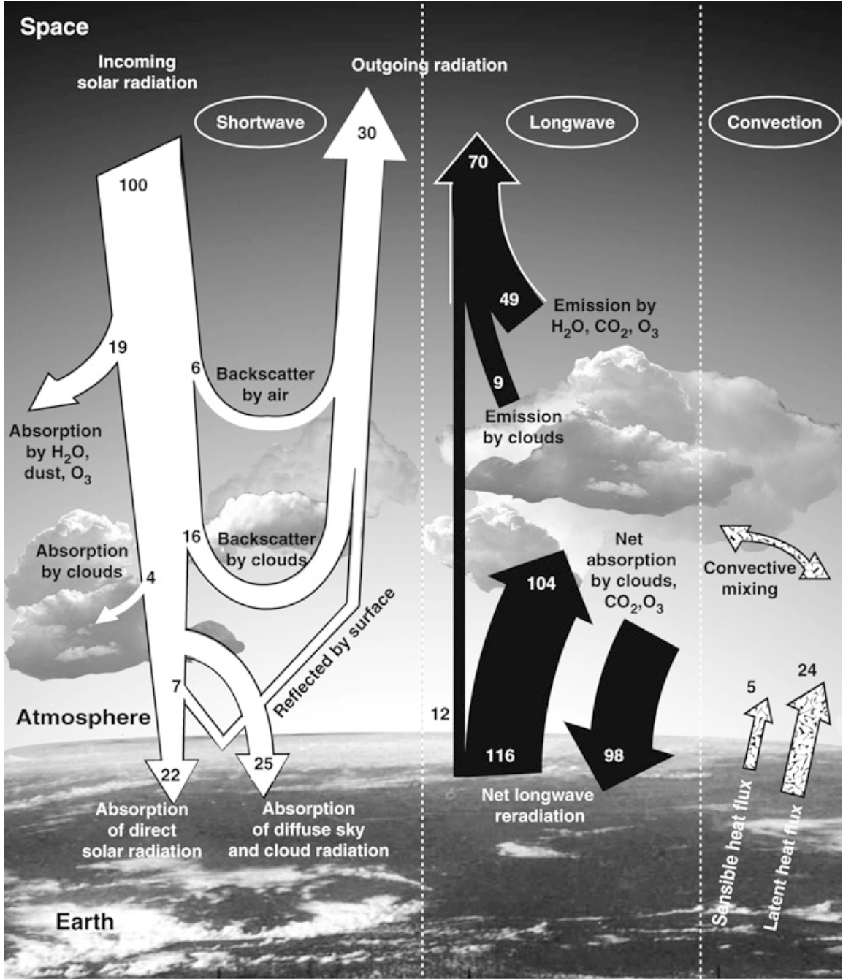
Notes:
The sun is the source of the energy available to drive Earth’s climate system
The sun emits most energy as high-energy shortwave radiation (UV: 8% of total; visible: 39% of total; near-infrared (53% of total)
On average, about 30% of incoming shortwave radiation is reflected back from space
Another 23% of incoming shortwave radiation is absorbed by the atmosphere, and the remaining 47% reaches Earth’s surface

Slide 9
The planetary boundary layer:
where the turbulent fluxes happen!

Slide 10
Notes:
Controlled by heat fluxes
Latent heat flux: where heat that evaporates water at the surface is subsequently released to the atmosphere as air parcels rise and cool, and the water vapor condenses, forming clouds and precipitation
Sensible heat flux: upward transfer of heat conducted from warm surface to the air immediately above it and is moved upward by convection
Convection: Convection is heat transfer through fluid (liquid or gas) movement, where warmer, less dense fluid rises and cooler, denser fluid sinks, creating circulating currents (convection currents) that distribute thermal energy
Also controlled by greenhouse gases that trap heat into atmosphere

Slide 11
Notes:
Controlled by heat fluxes
Latent heat flux: where heat that evaporates water at the surface is subsequently released to the atmosphere as air parcels rise and cool, and the water vapor condenses, forming clouds and precipitation
Sensible heat flux: upward transfer of heat conducted from warm surface to the air immediately above it and is moved upward by convection
Convection: Convection is heat transfer through fluid (liquid or gas) movement, where warmer, less dense fluid rises and cooler, denser fluid sinks, creating circulating currents (convection currents) that distribute thermal energy
Also controlled by greenhouse gases that trap heat into atmosphere

Slide 12
Aerosols
Atmospheric particles
Reflect incoming radiation back to space
What’s the climate impact?

Slide 13

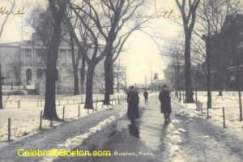
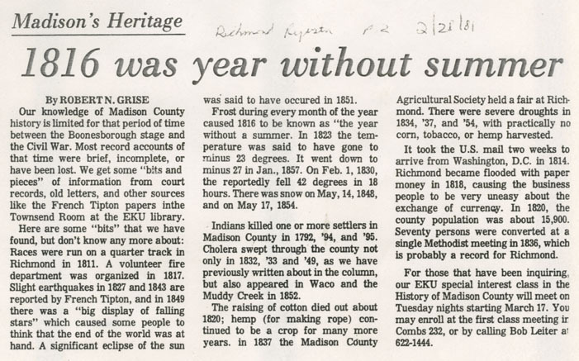
June 6th, 1816
Mount Tambora erupts (April 5th, 1815)

Slide 14
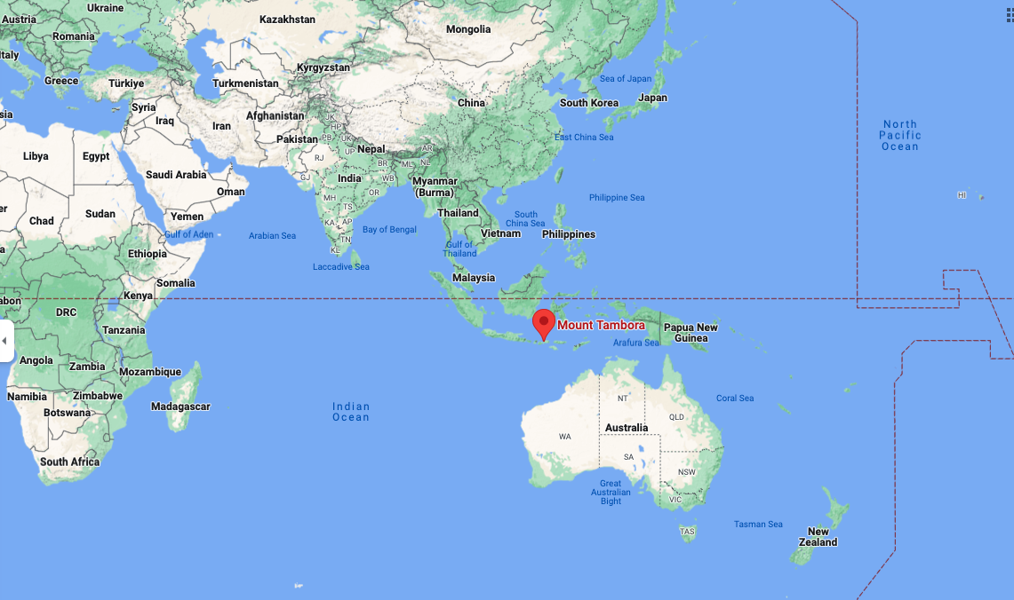

Slide 16
Notes:
Controlled by heat fluxes
Latent heat flux: where heat that evaporates water at the surface is subsequently released to the atmosphere as air parcels rise and cool, and the water vapor condenses, forming clouds and precipitation
Sensible heat flux: upward transfer of heat conducted from warm surface to the air immediately above it and is moved upward by convection
Convection: Convection is heat transfer through fluid (liquid or gas) movement, where warmer, less dense fluid rises and cooler, denser fluid sinks, creating circulating currents (convection currents) that distribute thermal energy
Also controlled by greenhouse gases that trap heat into atmosphere

Slide 17
Albedo
Radiation reflected by a surface
High degree of variability in albedo of Earth’s surface
Notes:
High albedo = surface with high reflectivity, reflecting a large percentage of incoming solar radiation back into space

Slide 18
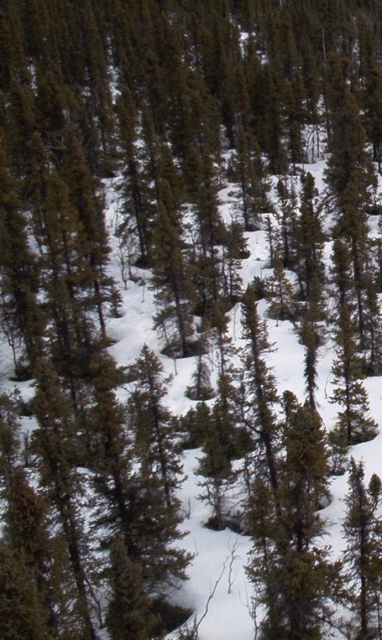
Albedo Examples
Oceans/lakes 0.03-0.10
Sea ice 0.30-0.45
Fresh snow 0.75-0.95
Tundra 0.15-0.20
Conifer forest 0.09-0.15
Broadleaf forest 0.15-0.20
Desert 0.20-0.45
Soil (wet) 0.05
Soil (dry) 0.40

Slide 19
Albedo Examples
Oceans/lakes 0.03-0.10
Sea ice 0.30-0.45
Fresh snow 0.75-0.95
Tundra 0.15-0.20
Conifer forest 0.09-0.15
Broadleaf forest 0.15-0.20
Desert 0.20-0.45
Soil (wet) 0.05
Soil (dry) 0.40
Can you rank these?

Slide 20
Amount reflected
Oceans/lakes 0.03-0.10
Sea ice 0.30-0.45
Fresh snow 0.75-0.95
Tundra 0.15-0.20
Conifer forest 0.09-0.15
Broadleaf forest 0.15-0.20
Desert 0.20-0.45
Soil (wet) 0.05
Soil (dry) 0.40

Slide 21
Notes:
Controlled by heat fluxes
Latent heat flux: where heat that evaporates water at the surface is subsequently released to the atmosphere as air parcels rise and cool, and the water vapor condenses, forming clouds and precipitation
Sensible heat flux: upward transfer of heat conducted from warm surface to the air immediately above it and is moved upward by convection
Convection: Convection is heat transfer through fluid (liquid or gas) movement, where warmer, less dense fluid rises and cooler, denser fluid sinks, creating circulating currents (convection currents) that distribute thermal energy
Also controlled by greenhouse gases that trap heat into atmosphere

Slide 22
Greenhouse gases
Without these gases in the atmosphere, Earth’s surface would be 33°C lower than it is today, and Earth would probably not support life, except perhaps
at hydrothermal vents in the deep ocean
Trap outgoing longwave radiation (up to 90%!)
Energy is re-radiated in all directions; portion directed back to Earth’s surface contributes to warming
Act like a blanket over the Earth’s surface
Keep us warm!

Slide 23
NOAA

Slide 24
Things that impact climate: Topography

Slide 25
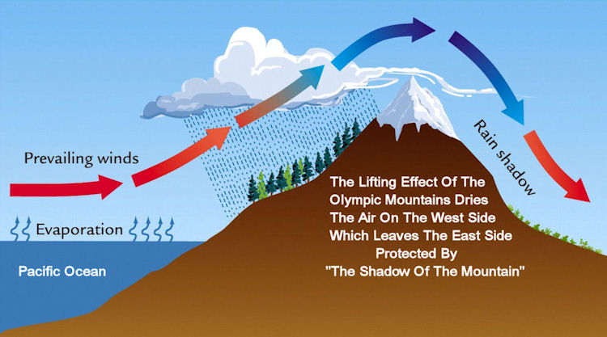
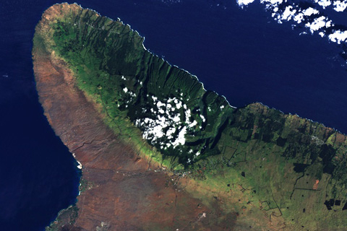
Rain Shadows
Big Island in Hawaii

Slide 26
Things that impact climate: Vegetation

Slide 27
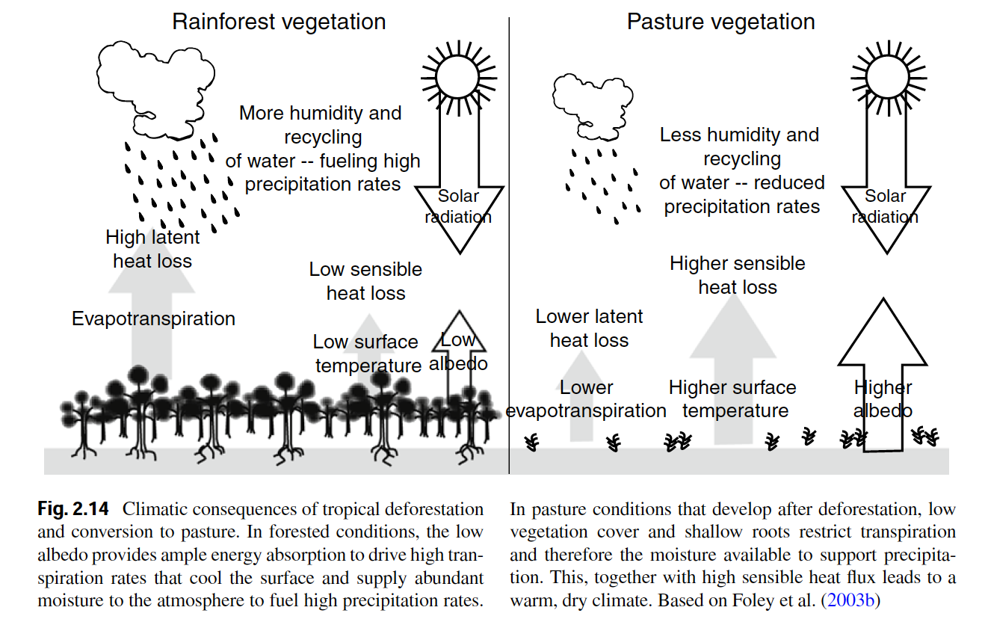
Vegetation itself can change climates

Slide 28
Soils

Slide 29
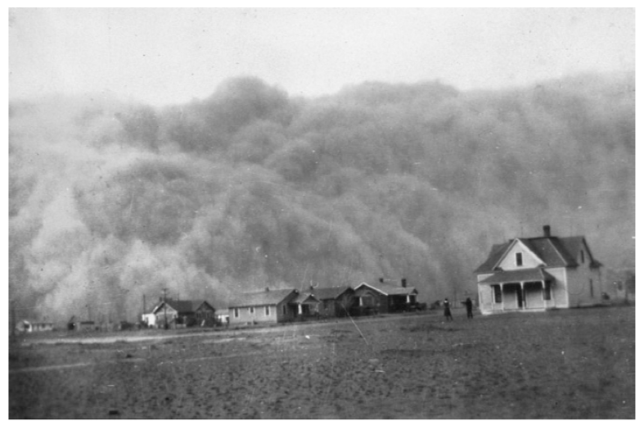
Soil Erosion and Formation

Slide 30
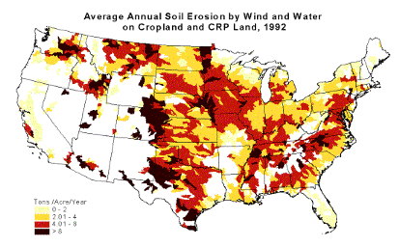
Soil Erosion

Slide 31
Erosion
Transfers carbon, nutrients and sediment from terrestrial to aquatic ecosystems
Often occurs faster than soils can be rebuilt
Leads to loss of fertility of agricultural soils

Slide 32
Erosion
Transfers carbon, nutrients and sediment from terrestrial to aquatic ecosystems
Often occurs faster than soils can be rebuilt
Leads to loss of fertility of agricultural soils

Slide 33
Formation: State factors
Parent material
Climate
Organisms
Topography/Relief
Time

Slide 34
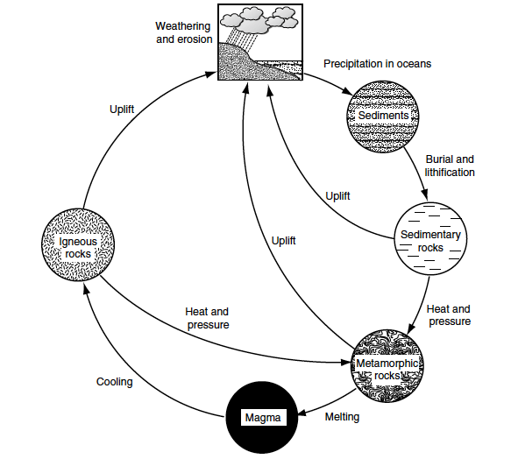
Parent Material
Physical and chemical properties of rocks
Uplift and weathering occur at different rates
100-200my

Slide 35
Climate
Temperature, moisture, CO₂, O₂
Determine weathering and soil formation

Slide 36
Organisms
Influence soil chemical and physical properties
Input litter quantity/quality
Uptake of mineral nutrients and input of organic nutrients

Slide 37
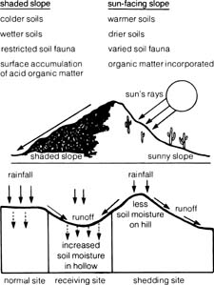
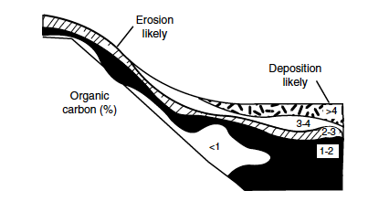
Topography
Influences climate, moisture availability, and particle transport

Slide 38
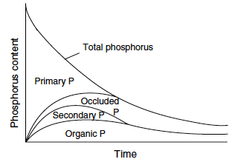
Time
Rocks weather slowly – minerals become occluded

Slide 39
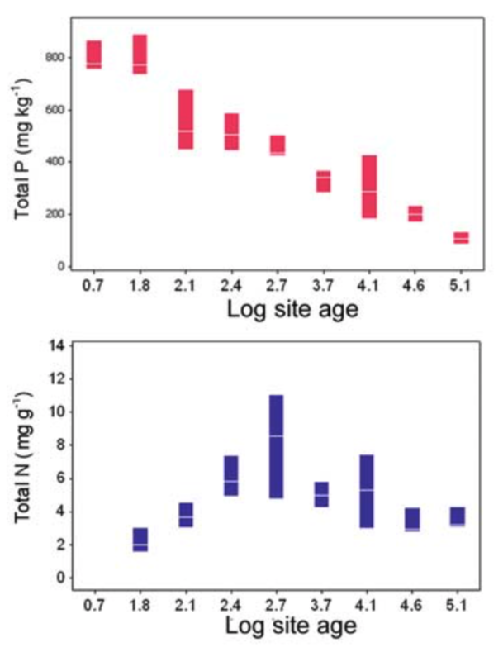
What could explain these trends?

Slide 40
Soil properties

Slide 41
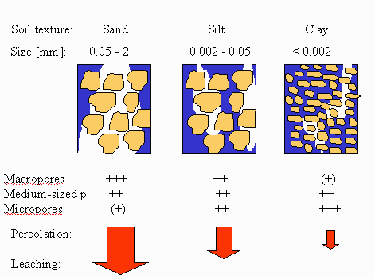
Soil Texture
Notes:
Percolation is the slow movement of liquid through porous materials or soil

Slide 42
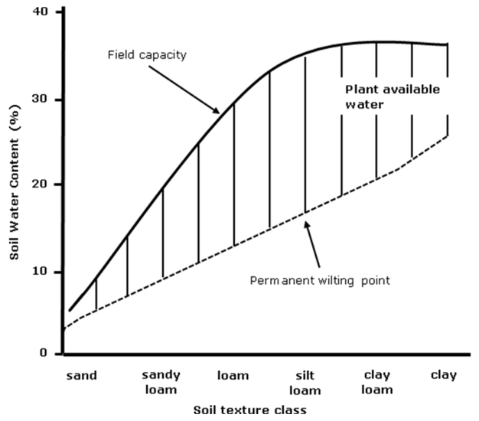
Physical: Soil texture
Sand: 0.05 – 2.0 mm
Silt: 0.002 – 0.05 mm
Clay: < 0.002 mm

Slide 43
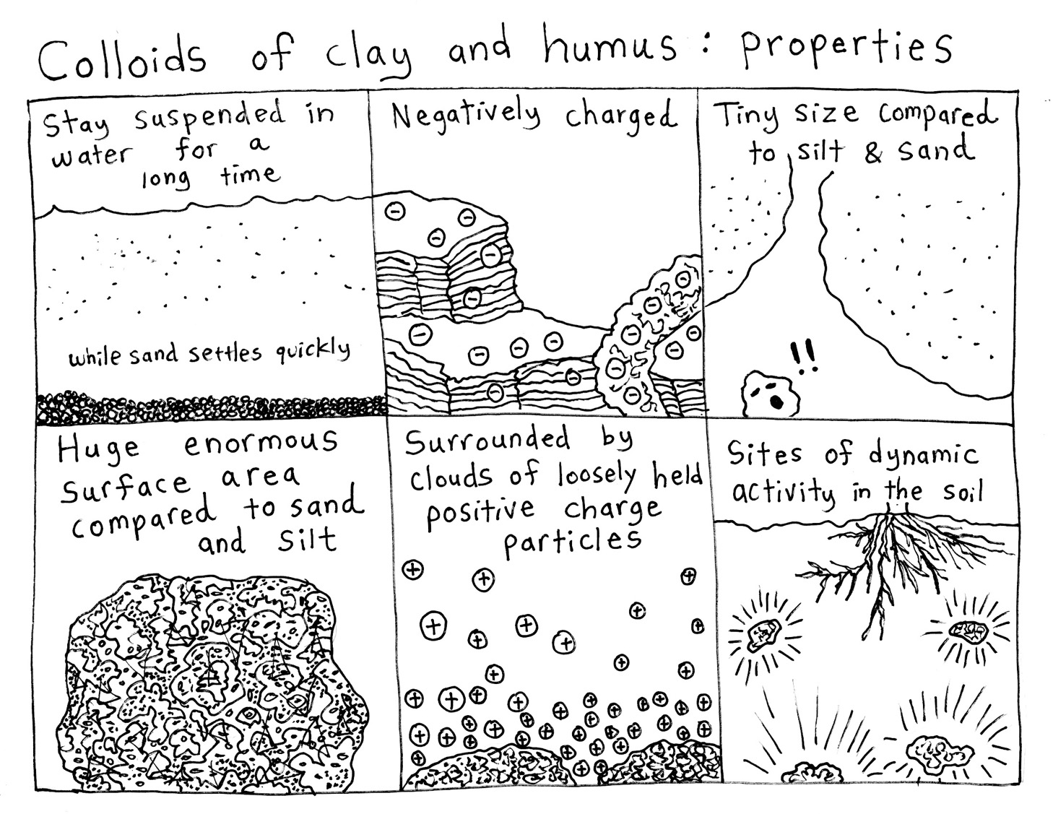

Slide 44
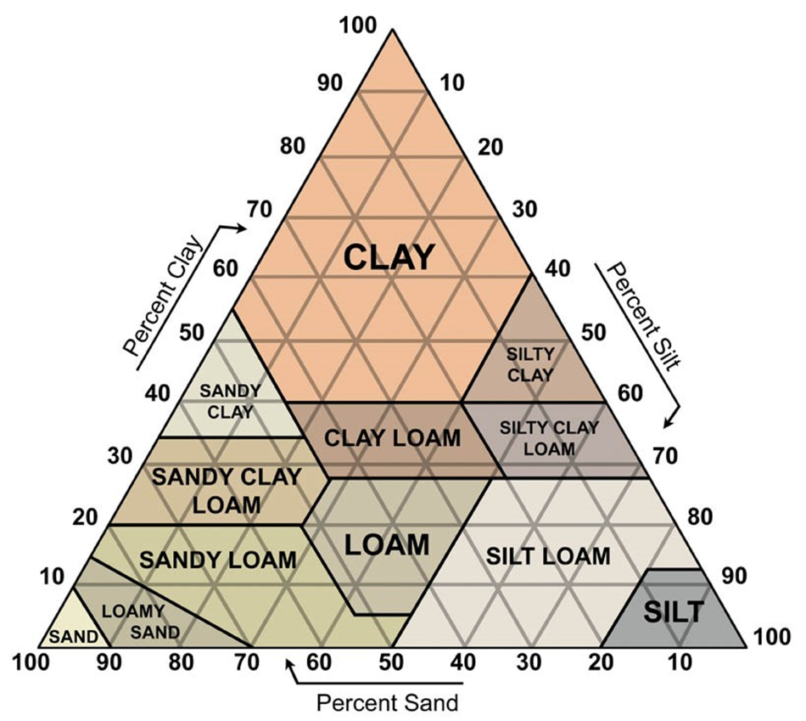
Physical: Soil texture

Slide 45
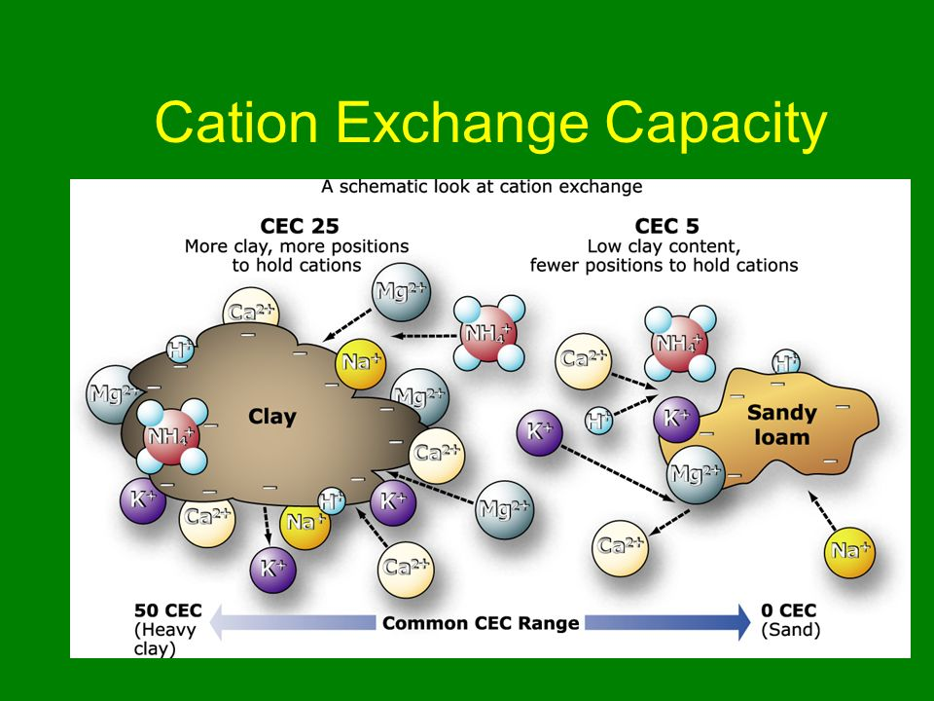

Slide 46
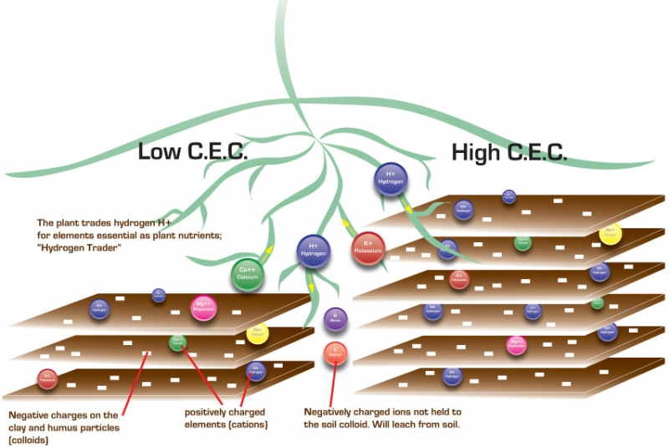

Slide 47
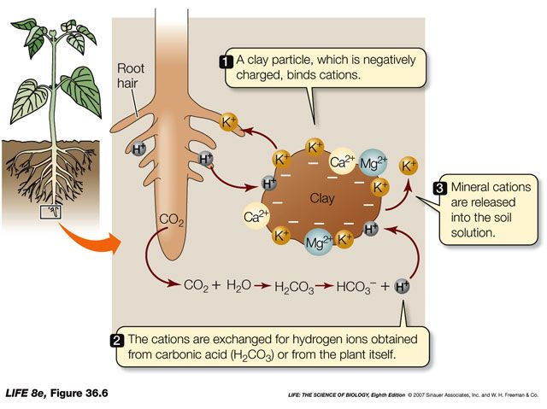
Chemical: Cation Exchange Capacity

Slide 48
Biomes

Slide 49
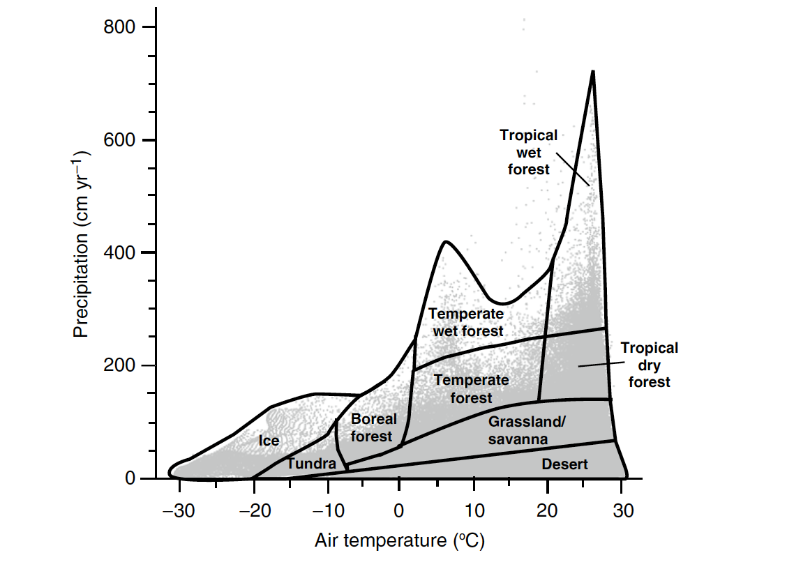
Climate determines biome distributions
Whittaker diagram

Slide 50
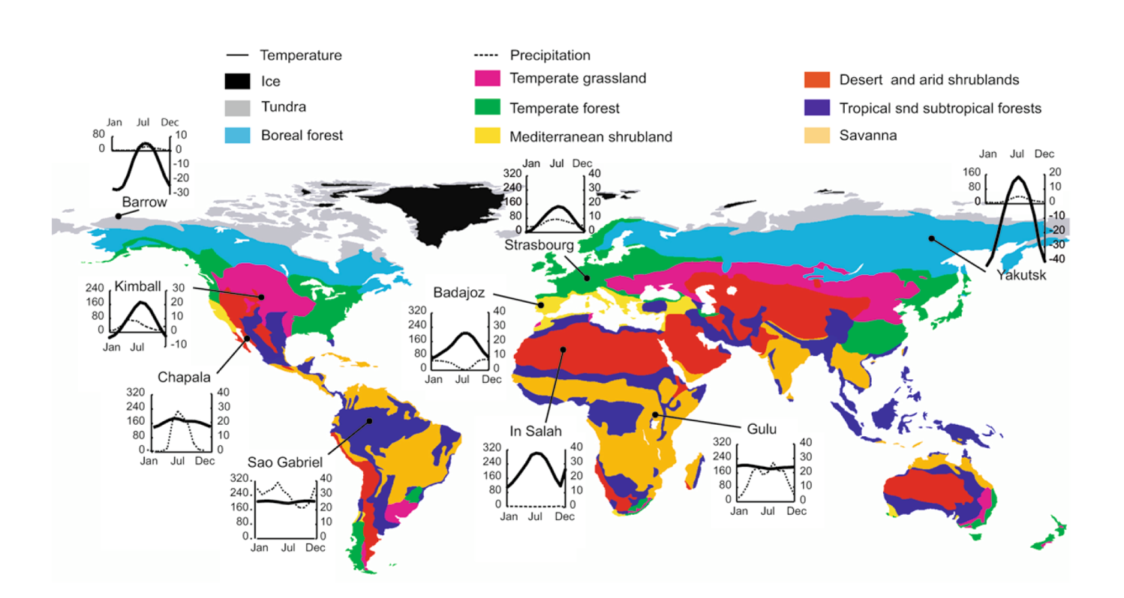
Biome distributions on Earth

Slide 51
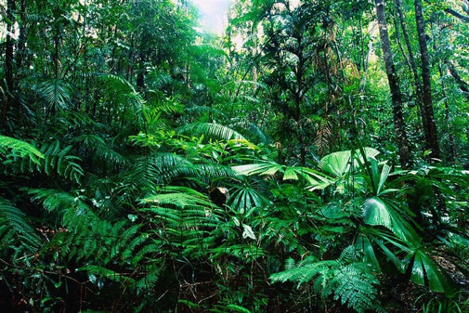
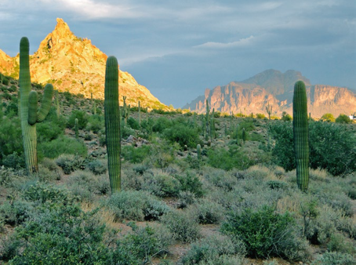
Characteristics of Biomes
Tropical Rainforest
Species diverse
Nutrient poor
Consistent climate
Desert
Bare soil
Calcium carbonate soils (basic)
Inconsistent climate

Slide 52
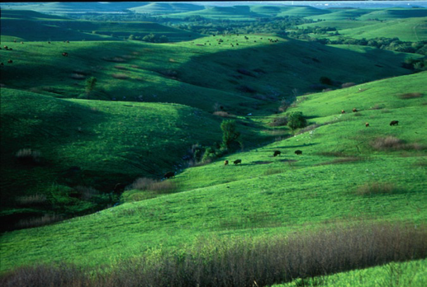
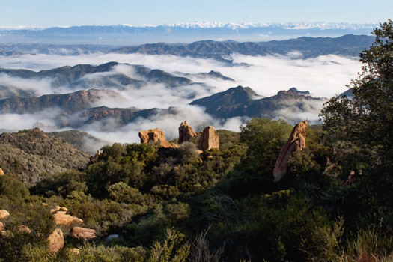
Temperate Grasslands
Clay soils
Deep soil carbon layer
Fire prone
Mediterranean shrublands
One of the most endangered habitats
Many endemic species
Only in coastal areas

Slide 53
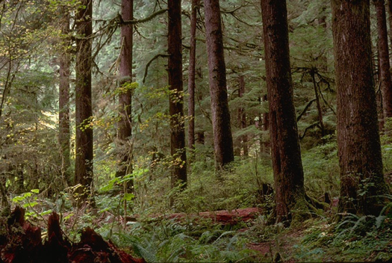
Temperate forests
Relatively species rich
Can have deciduous and non-deciduous trees
Taiga (Boreal forests)
Species poor
NPP in growing season can be as large as tropical forests
Experiencing warming at faster rates

Slide 54
What is our biome?

Slide 55
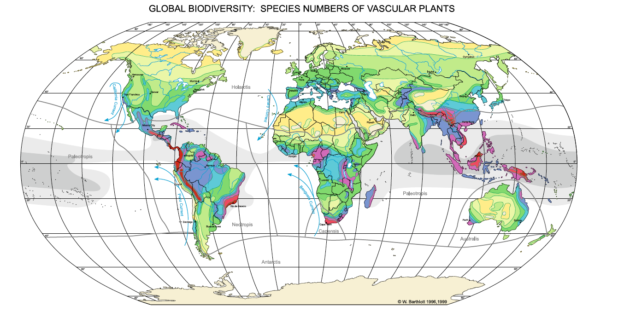
Latitudinal diversity gradient
Applies to plants and animals, but not necessarily microbes

Slide 56
Latitudinal diversity gradient
WHY?????
Applies to plants and animals, but not necessarily microbes

